Slide 1


Exact Factorization Adventures for Electrons, Nuclei, and Photons
Patricia Vindel Zandbergen
Lionel Lacombe
Norah Hoffmann
Bart Rosenzweig
Neepa T. Maitra
Rutgers University at Newark
Notes:
Thank you so much…I’ve been so lucky to have some amazing people to work with in the group, and its their work I will be telling you about. Patricia is a wonderful postdoc in the group without whom the first part of the talk could not exist. In the second part of the talkyou’ll hear about work from the other three shown here, Lionel Lacombe who last month joined Lucia Reining group in Paris on Marie-Curie, Norah Hoffman who was joint PhD student with Angel Rubio, now postdoc at Columbia with Tim berkelbach, and Bart Rosenzweig who was an undergraduate Hunter college now pursuing PhD in math at Ohio State.

Slide 2

Outline
The exact factorization approach (in a nutshell)
Exact-factorization-based surface hopping
-- first-principles decoherence correction
-- electronic transitions induced by the quantum momentum
Extension to photons in polaritonic chemistry
-- cavity-modified time-dependent potential energy surfaces
-- understanding errors in classical trajectory methods for photons
Notes:
So actually yesterday I was checking the website of the conference, and googled vista, pressing return a bit quickly, which gave me this definition. This gave me pause since in a way, exact factorization is like that. I have found it’s given me very pleasing views on dynamics, from formal, pictorial, and recently practical viewpoint, and I hope to convey some of that to you today. In a sense there is also can be a bit of. a long opening to get to some of these things (not narrow), which can be fun, since there are all sorts of interesting things to figure out. I hope to share some of that vista with you today.
So part of the talk emphasizes a very practical use of the XF, while the other part emphasizes more the insight it can give

Slide 3
just so we are on the same starting page…
Exact molecular Hamiltonian
All nuclear coordinates
e.g. laser field
All electronic coordinates
Notes:
So I probably don’t need this for this audience, but just to make sure we’re on the same page to start, this is the Hamiltonian we’ll be looking at – for electrons and nuclei with possibly classical light fields applied. The Born Huang expansion, infinite sum over Born-Oppenheimer basis states, offers an exact solution, and exact starting point for approximations to this equation, but another starting point is offered by the exact factorization.

Slide 4
Exact Factorization (XF) Approach in a Nutshell
For electron-nuclear systems, exact solution to
is uniquely* written as a single correlated product:
where
nuclear wavefunction (marginal):
satisfies a TDSE with potentials that depend on Φ_{R}
electronic wavefunction (conditional):
satisfies a more complicated eqn with coupling terms that depend on χ
In particular: time-dependent potential energy surface (TDPES)
and TD Berry connection
* up to an (R,t)-dependent phase transformation
A. Abedi, N.T. Maitra, and E.K.U. Gross, PRL 105, 123002 (2010); JCP 137, 22A530 (2012)
F. Agostini & E.K.U. Gross, Eur. Phys. J. B. 94, 179 (2021)
Hardy Gross Vista Talk! January 2021
Notes:
One can show that the exact soln can be written as. Single correlated product: maginal and conditional . This looks like the BO app but in fact is exact – and the eqns the two parts satisdy are definitely not BO. They have corrections due ot the correlation with each other – the nuclear equation is just beautiful – it has the form oa TDSE but with potentials scalar and vector that explicitly dep on the conditional. This means in particular that one can interpret the potentials used in traditional methods directly by comparison with these exact potentials (we will see an example of that in the second part of the talk). The elec wfn is not so fortunate, the equation is much more omplicated than a TDSE, with coupling terms depending on the nuclear wavefn. You can see more detail about these in thesepapers, including this really niec review of Federicas, and also a Vista talk of Hardy’s in Janyary

Slide 5
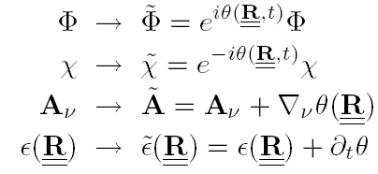
Equations for the exact electronic and nuclear wavefunctions
exact TDPES
exact TD Berry connection
Eqns form-invariant under the gauge-like transformation:
A. Abedi, N.T. Maitra, and E.K.U. Gross, PRL 105, 123002 (2010); JCP 137, 22A530 (2012)
Notes:
Skip this slide – put it at the end ?
Berry connection appears without any adiab separation. This vector potential arises purely due to the interaction with the electronic system. Very interesting relation between this and the nuclear velocity field. When can it be gauged away? When it cannot be, means one has geometric phase effects – the curl is non-zero.
Recent studies show that in cases where the BO wavefn has a topological phase factorwhen encircling a CI, the exact one picks up a geometric phase rather than a topol phase, i.e. it’s not pi except in the infinite mass limit. It can still be non-zero (although path dep?), e.g. in dynamical Jahn-Teller models of transition metal ions in bulk crystals or pseudorotating molecules. (RTG16) (Dynamic Jahn-Teller effects can result in 'pseudorotation', which is rotation of a distortion. This should not be confused with rotation of a real molecule. C60 movie online)
Perhap if look at nuc eqn first, see that it looks a lot like what traditional BO-like approaches might write down…except for the details of the terms in red boxes. Have a scalar pot – in the place that the usual PES would be – call this tdpes and can see that it depends on the electroic wfn, but also a vector potential – resembling a Berry conection..(more in a min) Elec eqn looks like trad approx. eqns used eg in ehrenfest, SH but different – quasiopertor depends on nuc. Wfn (not just param dep)_
These eqns ae form invariant

Slide 6

Exact factorization has gone in all sorts of different directions…
Reverse factorization
Electron-electron factorization
Mathematical stability
Electronic embedding: strong correlation
Geometric phase
Density functionalization
Polaritonic chemistry
Mixed quantum-classical methods
Gaining insight into correlated dynamics of coupled quantum subsystems
Practical tool – once we make some approximations!!
Notes:
Offering a new/fresh perspective and insight on problems butprobably the most practical impact has been so far in the development of MQC methods
(Semiclassical approxs are never unique since the hbar expansion is asymptotic )
Very nice method, already seeing some interesting applications on complext systems. But it’s not the only thing you can do. In particular, if you are a bit impatient and don’t want to wait for all your trajectories to talk to each other before moving on to the next time step, there is SH method proposed.

Slide 7
Outline
The exact factorization approach (in a nutshell)
Exact-factorization-based surface hopping
-- first-principles decoherence correction
-- electronic transitions induced by the quantum momentum
Extension to photons in polaritonic chemistry
-- cavity-modified time-dependent potential energy surfaces
-- understanding errors in classical trajectory methods for photons
Notes:
So actually yesterday I was checking the website of the conference, and googled vista, pressing return a bit quickly, which gave me this definition. This gave me pause since in a way, exact factorization is like that. I have found it’s given me very pleasing views on dynamics, from formal, pictorial, and recently practical viewpoint, and I hope to convey some of that to you today. In a sense there is also can be a bit of. a long opening to get to some of these things (not narrow), which can be fun, since there are all sorts of interesting things to figure out. I hope to share some of that vista with you today.
So part of the talk emphasizes a very practical use of the XF, while the other part emphasizes more the insight it can give

Slide 8
Mixed Quantum-Classical Approximations based on the XF
Coupled-Trajectory MQC
Take classical limit of the nuclear equation, expand , & approximate some terms based on exact studies…
→ CTMQC = Ehrenfest + coupled-trajectory terms in both electronic and nuclear eqns.
Unambiguous and well-defined terms yield wavepacket splitting and decoherence
F. Agostini, S. K. Min, A. Abedi, and E. K. U. Gross, J. Chem. Theory Comput. 12, 2127 (2016); S. K. Min, F. Agostini, I. Tavernelli, E. K. U. Gross, J. Phys. Chem. Lett. 8, 3048 (2017).
F. Agostini & E.K.U. Gross, Eur. Phys. J. B. 94, 179 (2021)
There are other possibilities for XF-based MQC methods ( e.g. for the impatient…)
XF-based surface hopping, SHXF (or, DISH-XF)
Nuclei: classical trajectory on one BO surface, hopping btn them via stochastic FSSH scheme
Electrons: follow the electronic eqn derived in CTMQC
Notes:
Take classical limit of the nuclear equation, constructing the nuclear wavepacket essentially through propagating an ensemble of coupled classical nuclear trajectories.
Been shown to successfully capture complex photochemical processes like ring-opening.., extended to spin-orbit, and also dynamics in laser fields.
One has to be a bit patient however – because in this scheme all the trajectories are coupled, you have to wait for all them to proceed with each time step. Also, there can be some instabilities, but these things are all being worked on in different ways, and it is a very promising approach.
Still, if you are a little impatient, there is another possibility:

Slide 9
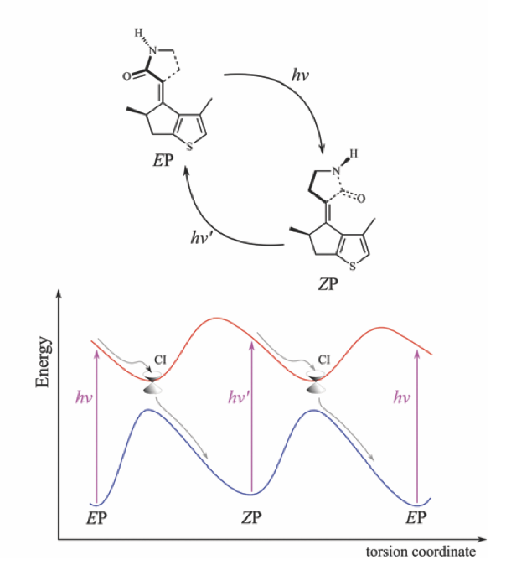
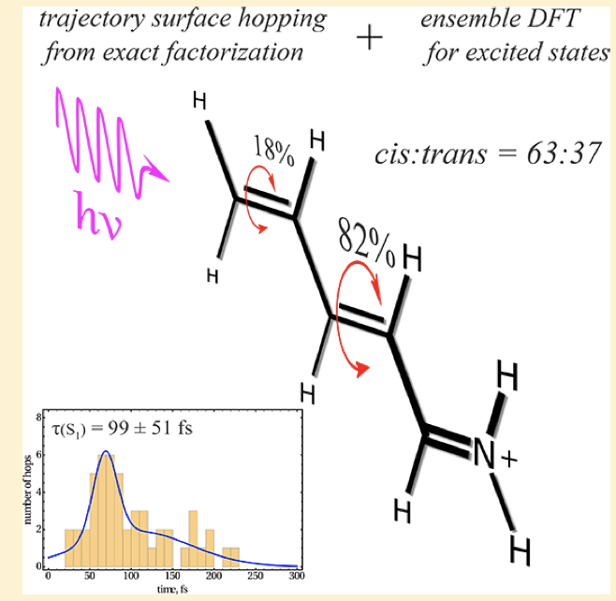
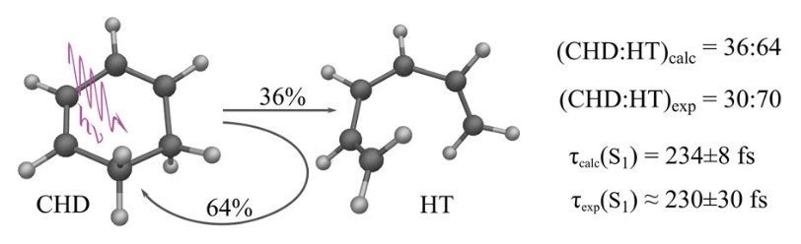


SHXF: Exact-Factorization-Based Surface Hopping
Same electronic equation as in CT-MQC but used in an FSSH scheme
Trans-Penta-2,4-dieniminium cation
Light driven molecular rotary motors
Ring opening in 1,3- cyclohexadiene
M Filatov, SK Min, KS Kim, J. Chem. Theo. Comp. 14, 4499-4512 (2019)
M Filatov, SK Min, CH Choi, Phys. Chem. Chem. Phys. 1 ,2489 (2019)
M Filatov, M Paolino, SK Min, CH Choi, Chem. Commun., 55, 5247 (2019)
M Filatov, SK Min, KS Kim, Mol. Phys. 117 , 1128-1141 (2019)
Seung-Kyu Min
UNIST, Korea
J.-K. Ha, I. S. Lee, S. K. Min, J. Phys. Chem. Lett. 9, 1097 (2018)
PyUNIxMD: A Python-based excited state molecular dynamics package. J. Comp. Chem. 42, 1755 (2021).

Slide 10
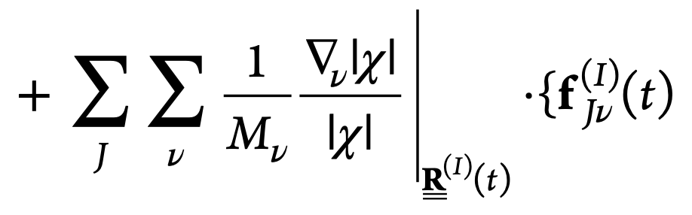
SHXF: Exact-Factorization-Based Surface Hopping
Same electronic equation as in CT-MQC but used in an FSSH scheme
← usual electronic eqn
correction derived from XF
To calculate the quantum momentum :
-- auxiliary trajectories coupled to each independent trajectory, launched on non-active states when the population becomes non-zero
J. K. Ha, I. S. Lee, S. K. Min , J. Phys. Chem. Lett., 9, 1097 (2018)
Notes:
First term BO, second is the non0adiabatic coupling we are familiar with, appearing also in Ehrenfest where electronic states are coupled to each other via nuclear motion, but here also another term here coupling the electronic states thorugh the wuantum momentu.
Since we have seen Try a simpler scheme: SHXF
given that the most crucial correction is to the electronic equation, tack on the EF correction to a standard scheme such as TSH or Ehrenfest.
EOM
Recently, a new TSH-type methodology has emerged [39] which is derived from the exact factorization of the electronic-nuclear wavefunction .The decoherence-induced surface hopping based on the exact factorization (DISH-XF) formalism takes advantage of the exact quantum description of electronic-nuclear correlations to accurately account for quantum decoherence effects on top of the conventional TSH formalism.
The same procedure as the FSSH algorithm is followed except for the electronic evolution, which requires additional computations for the decoherence correction.
First, to calculate the quantum momentum, DISH-XF exploits fictitious trajectories coupled to each independent (real) trajectory. We generate an auxiliary trajectory RK as on each BO state that is not equal to the running state (K different from L) when the BO population becomes nonzero at time t . We assume that the auxiliary trajectory follows uniform velocity motion ḋuring the time interval [t!,t! + %t], and we obtain the velocity RK(t′) by uniform rescaling of Ṙ(t′) to satisfy the energy conservation law.
If the kinetic energy term for the Kth state becomes negative, the velocity RK (t′) is set to zero. Finally, if pop becomes
(numerically) zero, we destroy the auxiliary trajectory on the Kth state. In this evolution scheme, the averaged trajectory over the auxiliary trajectories mimics the Ehrenfest trajectory.
During the time evolution of auxiliary trajectories, we can calculate the quantum momentum at the R (t) by constructing Gaussian nuclear density centered at each R(I)(t) with a uniform variance (sigma).
Then the quantum momentum (x/x) yields …
The phase term is derived as the time integration the BO force according to the previous works or it can be approximated to a time integration of momentum change at the Kth state because grad(EBO) it the momentum change of the vth nucleus at the Ith state for an infinitesimal time.
The term is “turned on” between the active and a non-active state whenever some population has transferred to the non-active state, as clear from the dependence on the population factor.

Slide 11

SHXF: Exact-Factorization-Based Surface Hopping
Same electronic equation as in CT-MQC but used in an FSSH scheme
← usual electronic eqn
correction derived from XF
Electronic transitions driven, not only by non-adiabatic couplings, but also by nuclear quantum momentum →
(i) decoherence
(ii) three-state intersections
J. K. Ha, I. S. Lee, S. K. Min , J. Phys. Chem. Lett., 9, 1097 (2018)
Notes:
First term BO, second is the non0adiabatic coupling we are familiar with, appearing also in Ehrenfest where electronic states are coupled to each other via nuclear motion, but here also another term here coupling the electronic states thorugh the wuantum momentu.
Effective coupling of
Since we have seen Try a simpler scheme: SHXF
given that the most crucial correction is to the electronic equation, tack on the EF correction to a standard scheme such as TSH or Ehrenfest.
EOM
Recently, a new TSH-type methodology has emerged [39] which is derived from the exact factorization of the electronic-nuclear wavefunction .The decoherence-induced surface hopping based on the exact factorization (DISH-XF) formalism takes advantage of the exact quantum description of electronic-nuclear correlations to accurately account for quantum decoherence effects on top of the conventional TSH formalism.
The same procedure as the FSSH algorithm is followed except for the electronic evolution, which requires additional computations for the decoherence correction.
First, to calculate the quantum momentum, DISH-XF exploits fictitious trajectories coupled to each independent (real) trajectory. We generate an auxiliary trajectory RK as on each BO state that is not equal to the running state (K different from L) when the BO population becomes nonzero at time t . We assume that the auxiliary trajectory follows uniform velocity motion ḋuring the time interval [t!,t! + %t], and we obtain the velocity RK(t′) by uniform rescaling of Ṙ(t′) to satisfy the energy conservation law.
If the kinetic energy term for the Kth state becomes negative, the velocity RK (t′) is set to zero. Finally, if pop becomes
(numerically) zero, we destroy the auxiliary trajectory on the Kth state. In this evolution scheme, the averaged trajectory over the auxiliary trajectories mimics the Ehrenfest trajectory.
During the time evolution of auxiliary trajectories, we can calculate the quantum momentum at the R (t) by constructing Gaussian nuclear density centered at each R(I)(t) with a uniform variance (sigma).
Then the quantum momentum (x/x) yields …
The phase term is derived as the time integration the BO force according to the previous works or it can be approximated to a time integration of momentum change at the Kth state because grad(EBO) it the momentum change of the vth nucleus at the Ith state for an infinitesimal time.
The term is “turned on” between the active and a non-active state whenever some population has transferred to the non-active state, as clear from the dependence on the population factor.

Slide 12
Comparison of XF decoherence with commonly used corrections:
SHXF
SHEDC
Granucci, Persico, Zoccante, J. Chem. Phys. 133, 134111 (2010)
Applied as an exp. damping of coefficients on inactive states
T = kinetic energy: unphysical size-extensivity; α parameter
.
AFSSH
Jain, Alguire, Subotnik, J. Chem. Theory and Comput. 12, 5256 (2016)
Decoherence rate is determined stochastically from this.
These all look completely different from each other!!
In particular, SHXF displays:
Non-linearity
ξ_{n} couples to all k, not just active state
Note ~ DISH: Akimov, Prezhdo JCTC 10 789 (2014); Jaeger, Fischer, Prezhdo JCP 137 22A545 (2012)
Notes:
I don’tt hink that you could say that these are really “derived” in a first-principles way, as the SHXF one is.
In particular, note the nonlinearity in the SHXF expression that moves us away from simple exponential dec time picture, property shared with DISH coherence time, although that is implemented in completely different way as a stocashtic rate determined by a decoherence time…

Slide 13
How does the XF-based surface hopping compare in practice with the traditional ones?
Will study:
(i) small molecules where reference AIMS results are available
(ii) three-state intersection in uracil cation, where reference MCTDH available
Use same initial conditions, same electronic structure method.
I’ll just show a couple of results, in the interest of time.
(i) P. Vindel Zandbergen, L. Ibele, J.-K. Ha, S.-K. Min, B. E. Curchod, N. T. Maitra, JCTC 17, 3852 (2021)
(ii) P. Vindel Zandbergen, S. Matsika, N. T. Maitra, in preparation (2021)

Slide 14
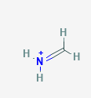
Example: Methaninimium Cation
After photoexcitation to S₁ → torsional motion → begins to photoisomerize and transfer to S₀
→ recrosses back to S₁ at a different nuclear configuration before slowly completing the transfer to S₀
For all calculations:
SA(2)-CASSCF(6/5) in 6-31G* basis set
70 initial conditions, each repeated 4 times for convergence (SH)
Time-step of dt = 0.25fs adequate for convergence.
SHXF σ = 0.056 au determined from C=N distribution

Slide 15
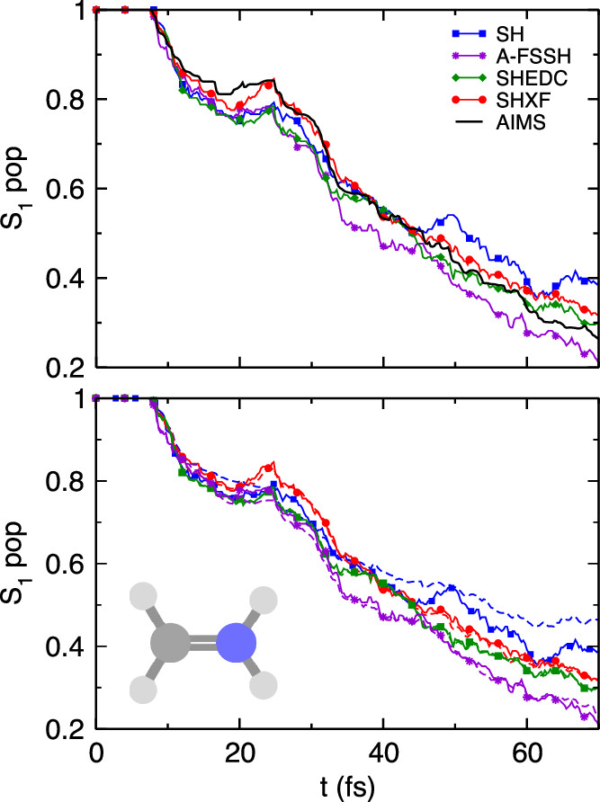
The results are overall similar between the different methods.
SHXF gives best overall agreement with AIMS (but they are all close), captures the back-transfer to S₁ enthusiastically
Poor internal consistency of SH evident, and is corrected by SHXF, SHEDC, and A-FSSH methods.
Yet, the decoherence terms looked so different!
Take a look at action on individual trajectories:
fraction of trajectories
dashed lines: electronic populations
P. Vindel Zandbergen, L. Ibele, J.-K. Ha, S.-K. Min, B. E. Curchod, N. T. Maitra, JCTC 17, 3852 (2021)

Slide 16
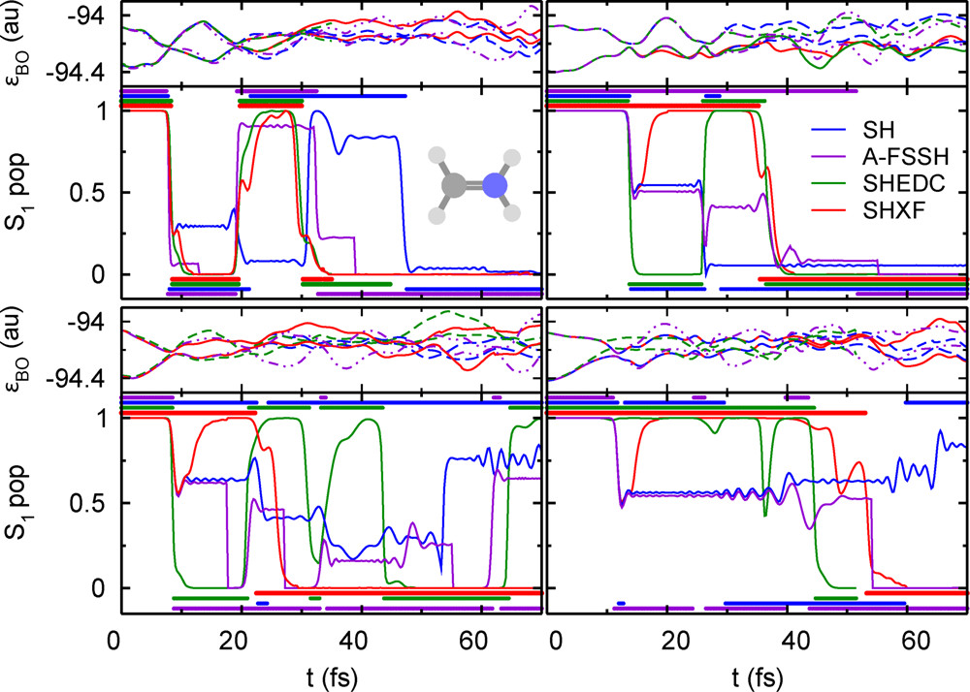
A sample of 4 trajectories:
The decoherence mechanisms on an individual trajectory are indeed very different.
Notes:
Action is very different, compare in particular green and red – SHXF certainly has more structure during the interaction region, unlike SHEDC which tends to monotonically push the population either down or up, the SHXF tends to have an oscillation – certainly cannot think of it has a simple decoherence time really; nonlinear structure in the term.
But the recorssings make this molecule a bit complicated, so lets look at a simpler molecule.

Slide 17
Another Example: Ethylene dynamics after photoexcitation to S₁
SA(3)-CASSCF(2/2) (Molpro); (6-31G*)/660 trajectories
Fraction of trajectories
Dashed lines here: electronic populations
Molecular Tully Models: L. M. Ibele , B. F. E. Curchod, Phys.Chem.Chem.Phys., 22 , 15183 (2020)
Notes:
We see this also in other molecules – these molec tully models for instance, where all the decoherence corrections corrected the internal consistency but gave very similar population dynamics and also geometries, despite having different forms.
We plot the S1 populations as determined by both the fraction of trajectories and the electronic popu- lations, computed from the SH, SHXF and SHEDC simulations.
For this system, the frac- tion of trajectories predicted by uncorrected SH is very close to the reference AIMS, but we see that there is a notable internal consistency error, as expected. Aver- aged over trajectories, the SHXF decoherence correction from exact factorization and SHEDC yield very similar results, increasing the population transfer compared to the uncorrected SH, agreeing less well with AIMS but not deviating too far. They also correct the internal consis- tency of the uncorrected SH, as evident from comparing with the electronic populations. Interestingly, EH gives very good populations until about 40fs when its popu- ation transfer slows down, and for this molecule EHXF overestimates the population transfer throughout.

Slide 18
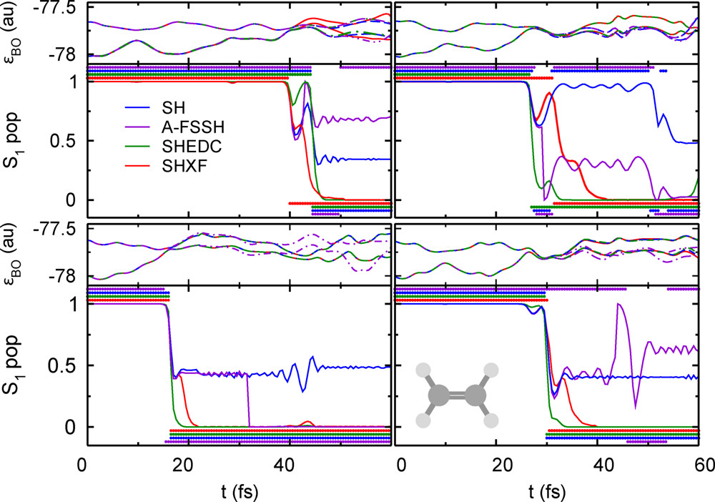
But again, on an individual trajectory level they act very differently:
XF decoherence is certainly not as simple as an expl decay
Reflected also in the “decoherence indicator”

Slide 19
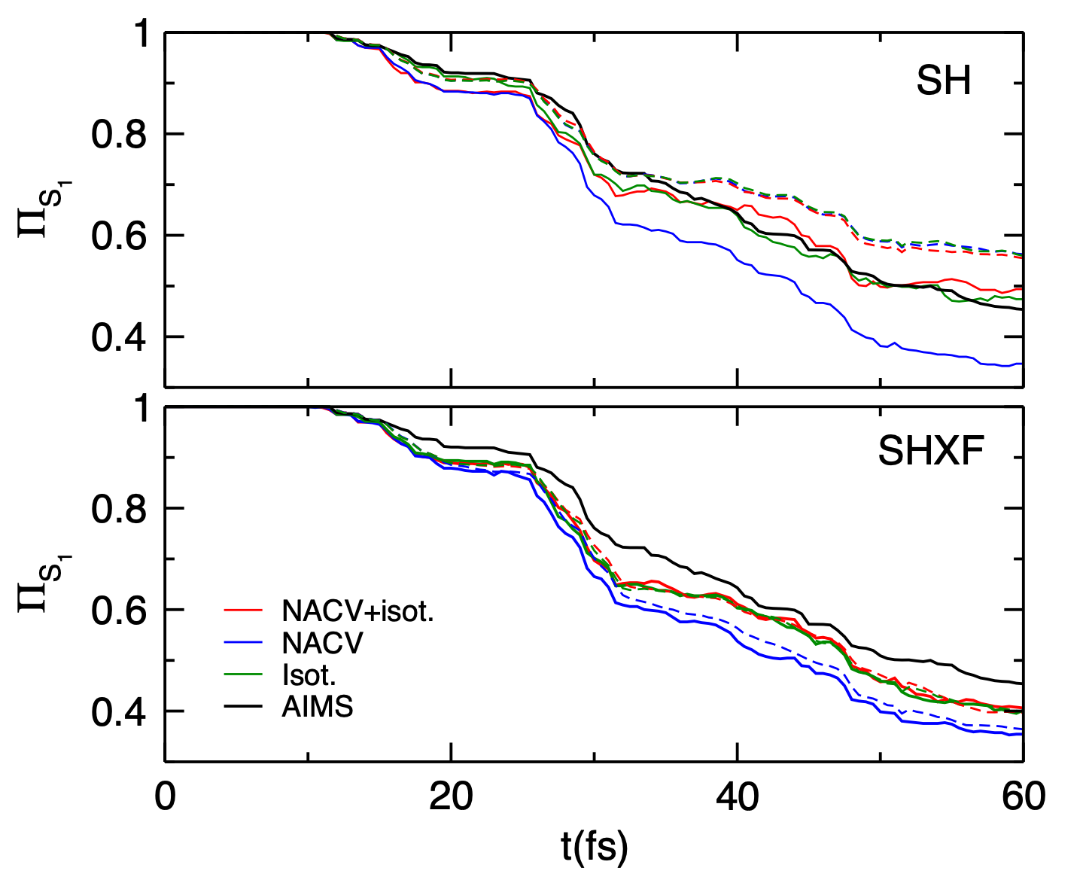
So, for these molecules, the SHXF and the different decoherence-corrected-SH approx’s all gave about the same averaged results, despite different action on individual trajectories …
…and in fact, the choice of momentum adjustment can give differences similar to the differences in decoherence corrections:
Is this always the case for some reason???
No!!
Notes:
the importance of the choice of velocity adjustment is evident in this figure, where the top panel shows the results of uncorrected SH with three different ways of velocity adjustment and the lower panel shows the SHXF case. The spread in the results shows that, in this case, the choice of velocity adjustment has just on the dynamics as the decoherence correction...

Slide 20
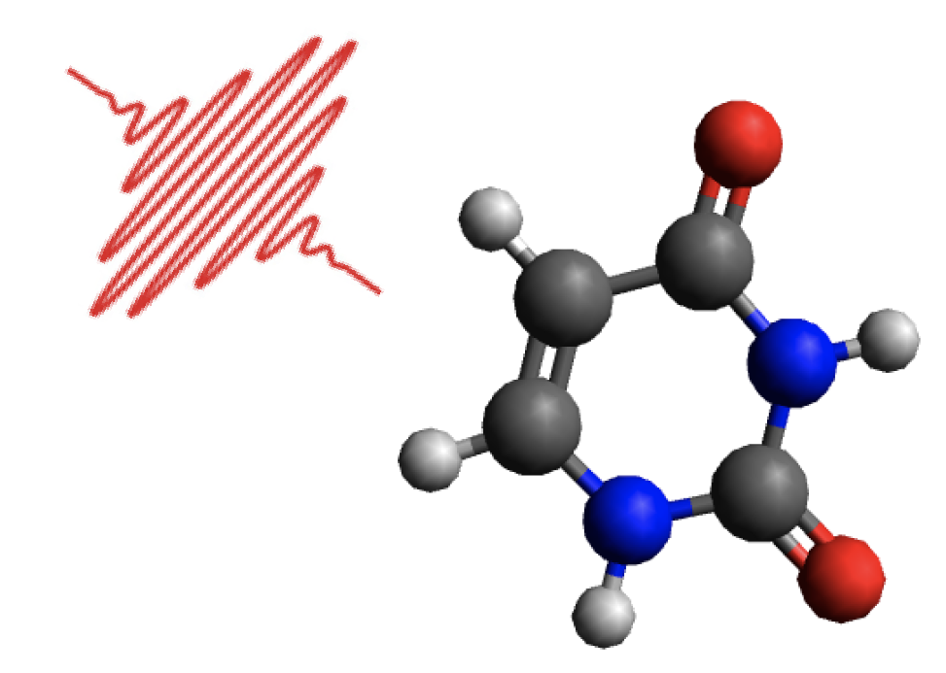
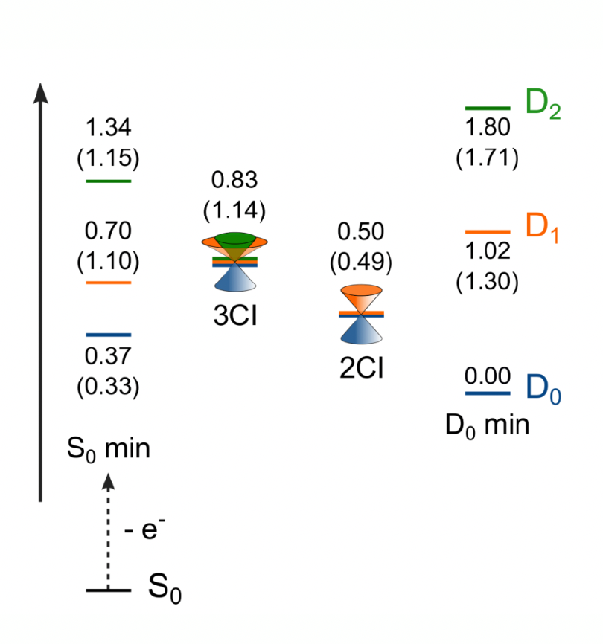
Electronic transitions mediated by the quantum momentum:
Dynamics through three-state intersection in uracil cation
Initial state: the adiabatic D₂ excited state of the cation, at the geometry of the neutral.
Vibronic coupling model fitted to EOM-IP-CCSD, with MCTDH calculations:
M. Assmann, H. Köppel, S. Matsika JPCA 119, 866 (2015)
S. Matsika, Chem. Phys. 349, 356 (2008)
Notes:
Start in the D2 state but at the geometry of the neutral ground-state
3-state CI has 5-D branching plane where the deg is lifted while 2-state has 2D branching plane where deg is lifted.Because the branching plane is higher-dim one might argue that 3-state Cis are not so important but in fact they have been found in sveral molecules, also in Rydberg/Valence region
M08 fiound the 2/3state CI in uracil cation using MRCI

Slide 21
Dynamics through three-state intersection in uracil cation
SHXF gives a significant improvement over the other SH methods!
We find about twice as many D₂-D₀ hops in SHXF c.f. the others.
Simultaneous rise of D₀ and D₁ → 3-state CI
Notes:
Also, A-FSSH interestingly is not internally consistent, but the others are.

Slide 22
Taking a closer look at individual trajectories reveals why:
Hopping probability has same form for all methods …
D₂
SHXF
SHEDC
SH
…but the XF term leads to starkly different coefficients before any hop occurs!
D₁
D₀
SHEDC: states only coupled pairwise to the active state (same in A-FSSH)
SHXF: quantum momentum couples all states with non-zero population
→ big differences when more than two states occupied at same time.
Notes:
In SHEDC, as soon as state becomes occupied the exponential damping sets in, computed relative to the running state. But with SHXF, the qmom couples all states that have non-zero population, not just the pairwise with the active state – leads to big differences.

Slide 23
Summary & Outlook so far..
XF provides a useful, derivable correction to surface-hopping that yields decoherence ..and more!
Mechanisms of decoherence on individual trajectory level are strikingly different
Results for observables may be overall somewhat similar to traditional decoherence-corrected methods for two-state interactions, but SHXF captures dynamics with three-state interactions that the others fail to do accurately.
But SH procedure has many ad hoc elements (e.g. velocity rescaling…), that can muddy the analysis of the effect of decoherence corrections…(Apply XF to QTSH? Martens, JPCA 123, 1110 (2019))
SH impractical when there are many surfaces, or laser fields... But XF is naturally suited in principle to that since it is based on a single time-dependent surface → develop other XF-based MQC methods?!
P. Vindel Zandbergen, L. Ibele, J.-K. Ha, S.-K. Min, B. E. Curchod, N. T. Maitra, JCTC 17, 3852 (2021)
P. Vindel Zandbergen, S. Matsika, N. T. Maitra, in preparation (2021)

Slide 24
Outline
The exact factorization approach (in a nutshell)
Exact-factorization-based surface hopping
-- first-principles decoherence correction
-- electronic transitions induced by the quantum momentum
Extension to photons in polaritonic chemistry
-- cavity-modified time-dependent potential energy surfaces
-- understanding errors in classical trajectory methods for photons
Notes:
So actually yesterday I was checking the website of the conference, and googled vista, pressing return a bit quickly, which gave me this definition. This gave me pause since in a way, exact factorization is like that. I have found it’s given me very pleasing views on dynamics, from formal, pictorial, and recently practical viewpoint, and I hope to convey some of that to you today. In a sense there is also can be a bit of. a long opening to get to some of these things (not narrow), which can be fun, since there are all sorts of interesting things to figure out. I hope to share some of that vista with you today.
So part of the talk emphasizes a very practical use of the XF, while the other part emphasizes more the insight it can give

Slide 25

Recent rekindling of interest in Cavity-QED
Achieve strong light-matter coupling without using any external field!
-- manipulate matter via vacuum fluctuations of the radiation field
-- possibility of “cleaner” control at lower (no) input power, than with laser fields
Hutchison, Schwartz, Genet, Devaux, Ebbesen, Angew. Chem. Int. Ed. 51, 1592 (2012).
spiropyran
merocyanine free
in-resonant cavity
Significant slowing of photoisomerization rate in resonant cavity
Many new phenomena:
e.g. enhanced conductivity, enhanced long-range excitation energy transfer, suppression of chemical reactions, superradiance…
Joel Yuen-Zhou and Wei Xiong
(UCSD)
Notes:
This has been known since early days of QM that strong light matter coupling can be achieved simply by confinement.eg Purcell
for a long time that properties of matter are modified when placed in a cavity, dating back to early days of QM. Purcell (1946) realized that the spont em rate of a molecule can be changed when put in resonant IR cavity.
Draw sketch? Two level and splitting 2g, g =sqrt(hbar omega_ph/2epsV)mu,
Now with experimental advances many things have become possible, e.g.
Lambda/2 mode formed btn 2 Ag mirrors (Fabry Perot), resonant with an excitation of molecules inside strongly interacting light-matter ”polaritonic” states – hybrid chracter Dramatic changes in spectrum – here black is absorbp of a cyanine dye molecule in free space, gets changed to the red when placed in vacuuTremendous interest in recent years – I am only just beginning to learn.
Essentially by placing molecules n cavities, eg formed by nanostructures, there can be very strong interactions btn light and matter even with the vacuum field of the cavity, esp when modes are resonant withmolecular transitions.
e.g.excitation energy-transfer over very long distances have been observed, orders of magniude larger, conductance enhancement, chemical reactions can be suppressed, collective effects can lead to supperradiance, coherence strong light emission fromseveral atoms coupled by cavity field. SO it’s a really exciting area. Modifying chemical landscape
Strong light-matter coupling by confinement
Spiroyran derivative under photoexcitation (at 330nm) undergoes ring cleavage to form a merocyanine. The extended conjugation of merocyanine results in strong absorption in the visible (red curve), c.f. black curve for spiropyran. Mechanism still a bit debated, thought to involve intermediate isomers, but reaction proceeds with first-order kinetics in soln.
Now put in cavity – PMMA film between Ag mirrors, s.t. fundamental mode of cavity is 560nm. UV radiation of spiropyran in cavity again forms the merocyanine
Inside cavity the new hybrid polaritonic states have energies +/- 350meV relative to the ex energy of the uncoupled merocyanine. Due to the vacuum field coupling..
PHotoisomerization rate slowed down significantly in the cavity structure when on resonance.
Essentially by placing molecules n cavities, eg formed by nanostructures, there can be very strong interactions btn light and matter even with the vacuum field of the cavity, esp when modes are resonant withmolecular transitions.
e.g.excitation energy-transfer over very long distances have been observed, orders of magniude larger, conductance enhancement, chemical reactions can be suppressed, collective effects can lead to supperradiance, coherence strong light emission fromseveral atoms coupled by cavity field. SO it’s a really exciting area. Modifying chemical landscape

Slide 26
Recent rekindling of interest in Cavity-QED: Polaritonic Chemistry
Key concept: resonantly coupled quantum subsystems
Hybrid light-matter states (polaritons)
How does this affect chemical reactions?
-- Molecule is resonant only at some nuclear configurations…
→ distorts the potential energy landscape
Notes:
This has been known for a long time that properties of matter are modified when placed in a cavity, dating back to early days of QM. Purcell (1946) realized that the spont em rate of a molecule can be changed when put in resonant IR cavity.
Draw sketch? Two level and splitting 2g, g =sqrt(hbar omega_ph/2epsV)mu,
Now with experimental advances many things have become possible, e.g.
Lambda/2 mode formed btn 2 Ag mirrors (Fabry Perot), resonant with an excitation of molecules inside strongly interacting light-matter ”polaritonic” states – hybrid chracter Dramatic changes in spectrum – here black is absorbp of a cyanine dye molecule in free space, gets changed to the red when placed in vacuuTremendous interest in recent years – I am only just beginning to learn.
Essentially by placing molecules n cavities, eg formed by nanostructures, there can be very strong interactions btn light and matter even with the vacuum field of the cavity, esp when modes are resonant withmolecular transitions.
e.g.excitation energy-transfer over very long distances have been observed, orders of magniude larger, conductance enhancement, chemical reactions can be suppressed, collective effects can lead to supperradiance, coherence strong light emission fromseveral atoms coupled by cavity field. SO it’s a really exciting area. Modifying chemical landscape
Strong light-matter coupling by confinement
Spiroyran derivative under photoexcitation (at 330nm) undergoes ring cleavage to form a merocyanine. The extended conjugation of merocyanine results in strong absorption in the visible (red curve), c.f. black curve for spiropyran. Mechanism still a bit debated, thought to involve intermediate isomers, but reaction proceeds with first-order kinetics in soln.
Now put in cavity – PMMA film between Ag mirrors, s.t. fundamental mode of cavity is 560nm. UV radiation of spiropyran in cavity again forms the merocyanine
Inside cavity the new hybrid polaritonic states have energies +/- 350meV relative to the ex energy of the uncoupled merocyanine. Due to the vacuum field coupling..
PHotoisomerization rate slowed down significantly in the cavity structure when on resonance.
Essentially by placing molecules n cavities, eg formed by nanostructures, there can be very strong interactions btn light and matter even with the vacuum field of the cavity, esp when modes are resonant withmolecular transitions.
e.g.excitation energy-transfer over very long distances have been observed, orders of magniude larger, conductance enhancement, chemical reactions can be suppressed, collective effects can lead to supperradiance, coherence strong light emission fromseveral atoms coupled by cavity field. SO it’s a really exciting area. Modifying chemical landscape

Slide 27
Extension of EF to include photons
Possible factorizations of wavefunction of coupled electrons, nuclei, and photons:
TDSE for the photonic system
TDSE for the nuclear system
Exact potential driving the nuclei when coupled to electrons and photons
N. Hoffmann, H. Appel, M. Rubio, N.T. Maitra, Eur. Phys. J. B 91, 180 (2018)
L. Lacombe, N. M. Hoffmann, N.T. Maitra, Phys. Rev. Lett. 123, 083201 (2019).
Electron-photon factorization:
A. Abedi, E. Khosravi, I. Tokatly, Eur. Phys. J. B. 91, 194 (2018).
Unlike polaritonic surfaces, the exact TDPES from XF directly correlates with proton motion

Slide 28
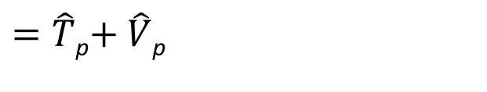
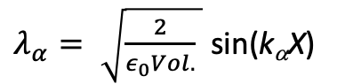
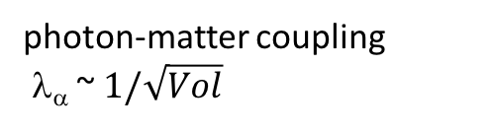
Simplest Hamiltonian for Systems of Correlated Nuclei, Electrons, and Photons
Non-relativistic, neglect spin-coupling, neglect any cavity-losses, dipole approximation in length gauge, no classical external fields →
displacement-field coordinate:
$=\hat{T}$_{p}$+ \hat{V}$_{p}
photon-matter coupling
λ_{α} ~ $1/\sqrt{Vol}$
e.g. 3D planar cavity:
$λ_{α}= \sqrt{\frac{2}{ε_{0}Vol.} }$ sin(k_{α}X)
Cohen-Tannoudji, Dupont-Roc, Grynberg, Photons and Atoms: Introduction to Quantum Electrodynamics (Wiley & Sons, 1989); Ruggenthaler, Tancogne-Dejean, Flick, Appel, Rubio, Nat. Rev. Chem. 2, 0118 (2018)
Notes:
Non-relativistic QED is the Pauli-Fierz form, and then make the dipole approx, Coulomb gauge, and neglect spin-coupling to get this H. ignoring any losses

Slide 29
A Motivation to choose the marginal as q:
Photonic parts of Hamiltonian are harmonic with bilinear coupling → is classical dynamics of Wigner-sampled initial state for photons exact?
in-cavity λ =0.005
in-cavity λ =0.001
If we treated the photon dynamics with classical trajectories in q, is it accurate?
L. Lacombe, N. M. Hoffmann, N.T. Maitra, Phys. Rev. Lett. 123, 083201 (2019).

Slide 30
A Motivation:
Photonic parts of Hamiltonian are harmonic with bilinear coupling → is classical dynamics of Wigner-sampled initial state for photons exact?
22 fs
30 fs
38 fs
Exact
Multi-trajectory Ehrenfest-photons (MTE)
Multi-trajectory Ehrenfest-photons & nuclei
Cavity-free
underestimate of photon number

Slide 31
Do we really care?!
MTE for photons is a practical way to account for many modes in the cavity
.. As more cavity modes are accounted for, dramatic changes in the dynamics (self-polarization)
Underestimation also seen in 400-mode 2LS and 3LS studies of Hoffmann, Schäfer, Rubio, Appel, Kelly, PRA 99 (2019)
Also, recent analyses of vibrational strong coupling in real systems use classical trajectories on the BO surface…
Want a sense of the size of the error
N. M. Hoffmann, L. Lacombe, A. Rubio, N. T. Maitra, J. Chem. Phys. 153, 104103 (2020)
Notes:
Fundamental cavity mode is far from resonant – one mode (black) is essentially identical to cavity-free…

Slide 32
Simplest example: Two-level system coupled to a single resonant cavity-mode
+
+
ω_{c} = ε_{e} – ε_{g.} coupling, λr_{eg} = 0.01
Initial state: |e> , zero photons
Plan: Find the exact qTDPES from XF, choosing q as the marginal.
Classically evolve on it & compare with MTE
B. Rosenzweig, N. M. Hoffmann, L. Lacombe, N.T. Maitra, in prep. (2021)

Slide 33
Simplest example: Two-level system coupled to a single resonant cavity-mode
Plan: Find the exact qTDPES from XF, choosing q as the marginal.
Classically evolve on qTDPES & compare with MTE
e.g.
B. Rosenzweig, N. M. Hoffmann, L. Lacombe, N.T. Maitra, in prep. (2021)
Notes:
Can look at effect of different components. In particular, MTE is like a weighted BO, so might ike to compare with force from just the wBO piece – but notice already here crucial difference – the MTE eqn lacks the q-dependence of the elec coeff but this q-dep is an intimate signature of electron-photon correlation. We will see that it leads to barriers in th emiddle of the potential driving the photon.

Slide 34
|χ(q,t)|²
MTE
QC on wBO
Exact
QM on wBO
QC on qTDPES
Exact
<-- exact qTDPES
Deviations from harmonic!
MTE cannot generate the barrier → smaller photon-number observed
B. Rosenzweig, N. M. Hoffmann, L. Lacombe, N.T. Maitra, in prep. (2021)

Slide 35
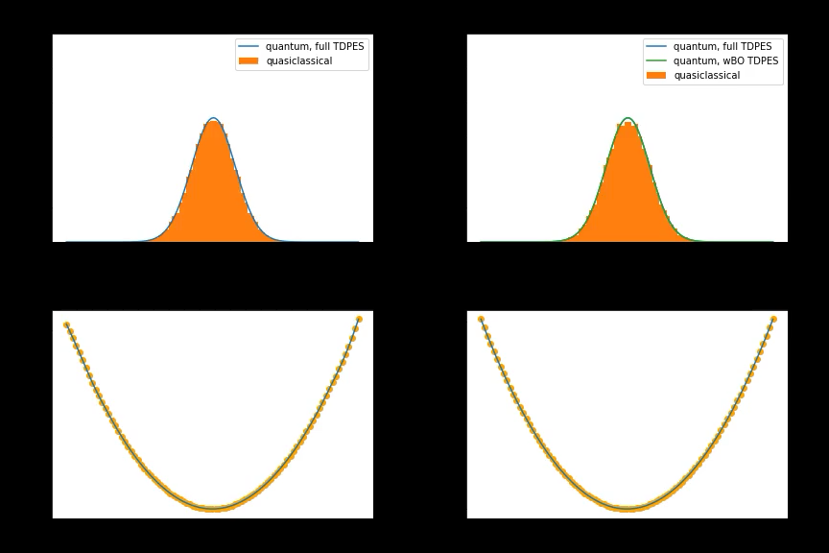

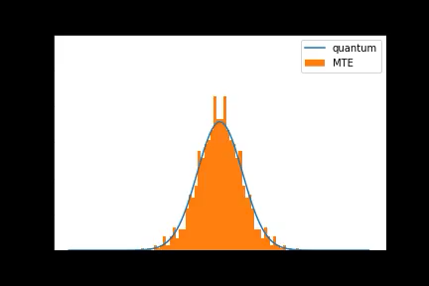
Movie

Slide 36
Summary/Outlook of the 2nd Part
A look at the exact potential driving photon dynamics reveals why quasiclassical propagation methods for photons tend to underestimate the photon number in stimulated emission phenomena
Barrier in qTDPES localized at q = 0 inherently associated with electron-photon correlation, completely missing in underlying force on MTE
Implications for polaritonic chemistry modeling?

Slide 37
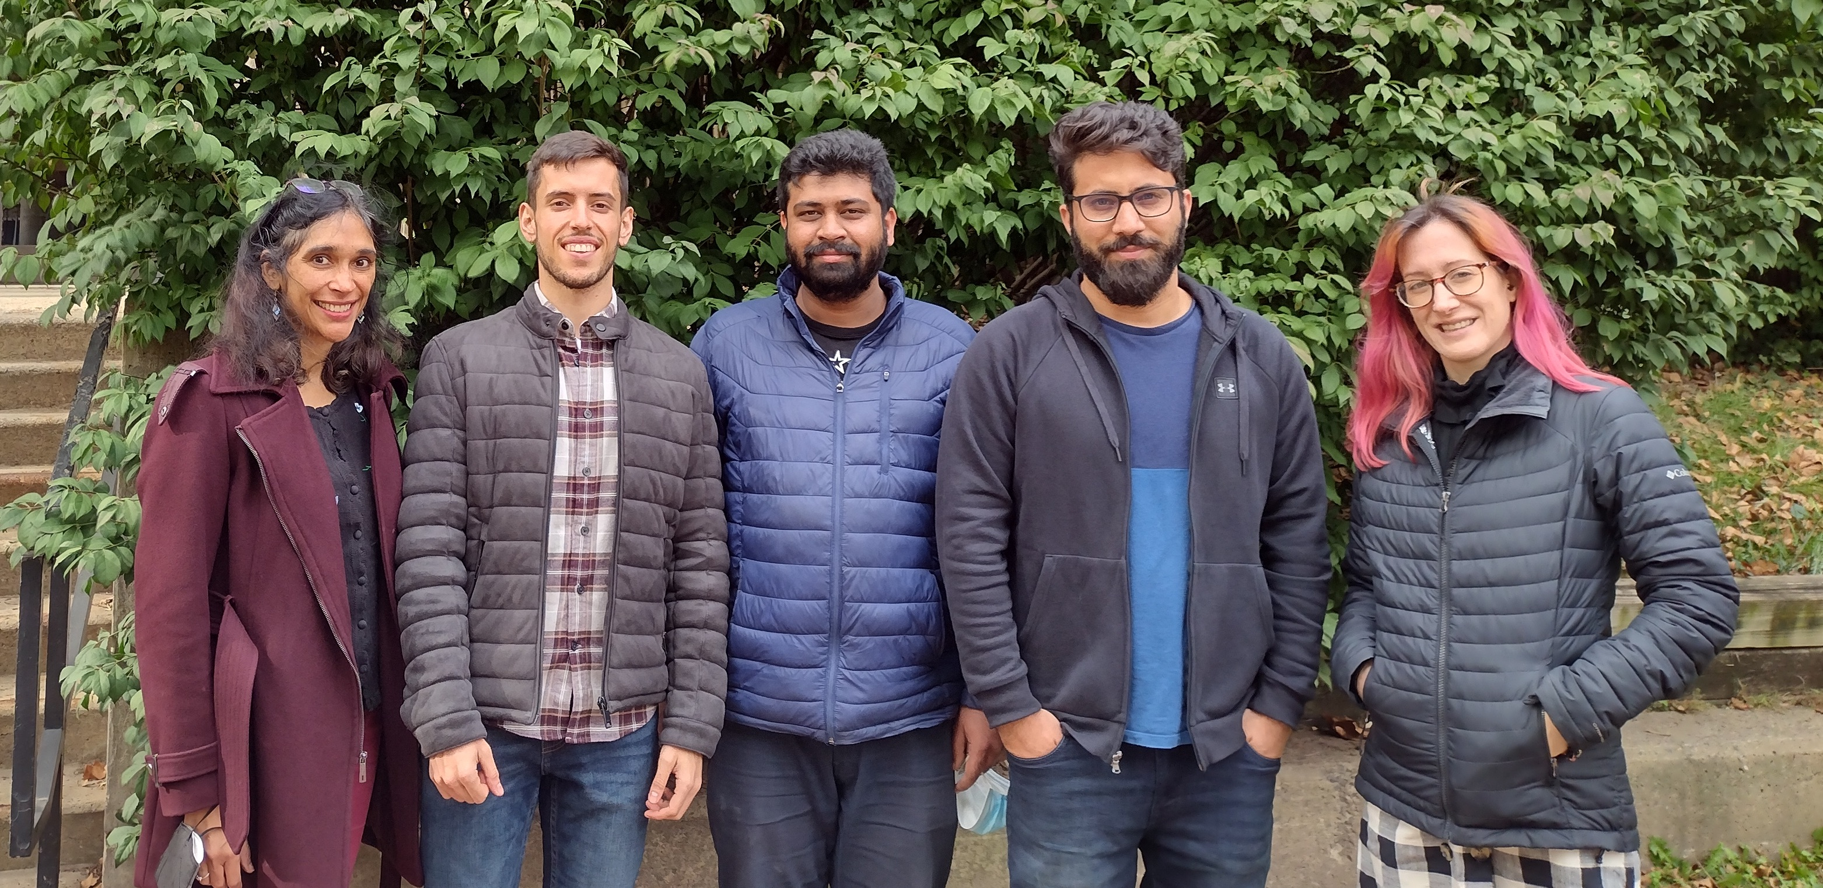

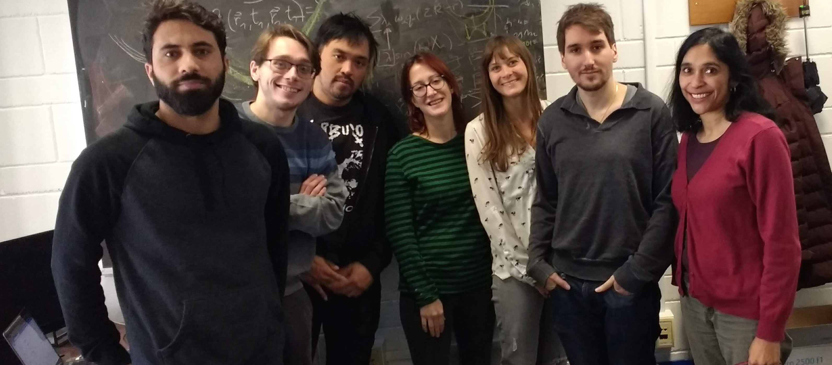


Thanks to: Alexey, Sergei, Fede, and the VISTA team
Fall 2021
Patricia Vindel Zandbergen
Fall 2019
Lionel Lacombe
Bart Rosenzweig
Norah Hoffmann
Jong Kwon Ha & Seung-Kyu Min (UNIST, Korea)
Lea Ibele & Basile Curchod (Durham, UK)
Spiridoula Matsika (Temple University)
And to you all for listening!

